Slide 1
COMP 2400
Week 2 - Friday

Slide 2
Last time
What did we talk about last time?
Math library
Character I/O

Slide 3
Questions?

Slide 4
Project 1

Slide 5
Project 2

Slide 6
Quotes
It ain't what you don't know that gets you into trouble. It's what you know for sure that just ain't so.
  Mark Twain

Slide 7
Preprocessor Directives

Slide 8
Preprocessor directives
There are preprocessor directives which are technically not part of the C language
These are processed before the real C compiler becomes involved
The most important of these are
  #include
  #define
  Conditional compilation directives

Slide 9
#include
You have already used #include before
  #include <stdio.h>
It can be used to include any other file
  Use angle brackets (< >) for standard libraries
  Use quotes (" ") for anything else
It literally pastes the file into the document where the #include directive is
Never #include .c files (executable code), only .h files (definitions and prototypes)
It is possible to have a circular include problem

Slide 10
#define
The primary way to specify constants in C is with a #define
When you #define something, the preprocessor does a find-and-replace
  Don't use a semicolon!
#define directives are usually put close to the top of a file, for easy visibility
#define SIZE 100
int main()
{
int array[SIZE];
int i = 0;
for (i = 0; i < SIZE; ++i)
array[i] = i*i;
return 0;
}

Slide 11
#define macros
You can also make macros with #define that take arguments
You need to be careful with parentheses
Constants and macros are usually written in ALL CAPS to avoid confusion
#include <math.h>
#define TO_DEGREES(x) ((x) * 57.29578)
#define ADD(a,b) ((a) + (b))
int main()
{
double theta = TO_DEGREES(2*M_PI);
int value = ADD(5 * 2, 7);
return 0;
}

Slide 12
Conditional compilation
You can use directives #if, #ifdef, #ifndef, #else, #elif and #endif
These are mostly used to avoid infinite include problems
Sometimes they will change what gets compiled based on compiler version, system libraries, or other stuff
#ifndef SOMETHING_H
#define SOMETHING_H
int something(int a, int b);
#endif

Slide 13
Other C Features

Slide 14
sizeof
We said that the size of int is compiler dependent, right?
  How do you know what it is?
sizeof is a built-in operator that will tell you the size of a data type or variable in bytes
#include <stdio.h>
int main()
{
printf("%d", sizeof(char));
int a = 10;
printf("%d", sizeof(a));
double array[100];
printf("%d", sizeof(array));
return 0;
}

Slide 15
const
In Java, constants are specified with the final modifier
In C, you can use the keyword const
Note that const is only a suggestion
  The compiler will give you an error if you try to assign things to const values, but there are ways you can even get around that
Arrays have to have constant size in C
Since you can dodge const, it isn't strong enough to be used for array size in C89
That's why #define is more prevalent
const double PI = 3.141592;

Slide 16
System limits
The header limits.h includes a number of constants useful in C programming
There are some for basic data types
float.h has similar data for floating-point types, but it isn't as useful for us
Constant | Typical Value | Constant | Typical Value
SCHAR_MIN | –128 | INT_MIN | –2147483648
SCHAR_MAX | 127 | INT_MAX | 2147483647
UCHAR_MAX | 255 | UINT_MAX | 4294967295
CHAR_MIN | –128 | LONG_MIN | –2147483648
CHAR_MAX | 127 | LONG_MAX | 2147483647
SHRT_MIN | –32768 | ULONG_MAX | 4294967295
SHRT_MAX | 32767 | CHAR_BIT | 8
USHRT_MAX | 65535

Slide 17
Other limits
limits.h has other system limits
C and Linux have their roots in old school systems programming
Everything is limited, but the limits are well-defined and accessible
You may need to know:
  How many files a program can have open at the same time
  How big of an argument list you can send to a program
  The maximum length of a pathname
  Many other things…

Slide 18
Getting these limits
For system limits, a minimum requirement for the maximum value is defined in limits.h
If you want the true maximum value, you can retrieve it at runtime by calling sysconf() or pathconf() (defined in unistd.h) with the appropriate constant name
#include <stdio.h>
#include <unistd.h>
int main()
{
long value = sysconf(_SC_LOGIN_NAME_MAX);
printf("Maximum login name size: %ld\n", value);
return 0;
}

Slide 19
Examples of system limits
limits.h Constant | Minimum Value | sysconf() Name | Description
ARG_MAX | 4096 | _SC_ARG_MAX | Maximum bytes for arguments (argv) plus environment (environ) that can be supplied to an exec()
none | none | _SC_CLK_TCK | Unit of measurement for times()
LOGIN_NAME_MAX | 9 | _SC_LOGIN_NAME_MAX | Maximum size of a login name, including terminating null byte
OPEN_MAX | 20 | _SC_OPEN_MAX | Maximum number of file descriptors that a process can have open at one time, and one greater than maximum usable
none | 1 | _SC_PAGESIZE | Size of a virtual memory page
STREAM_MAX | 8 | _SC_STREAM_MAX | Maximum number of stdio streams that can be open at one time
NAME_MAX | 14 | _PC_NAME_MAX | Maximum number of bytes in a filename, excluding terminating null byte
PATH_MAX | 256 | _PC_PATH_MAX | Maximum number of bytes in a pathname, including terminating null byte

Slide 20
char values
C uses one byte for a char value
This means that we can represent the 128 ASCII characters without a problem
  In many situations, you can use the full 256 extended ASCII sequence
  In other cases, the (negative) characters will cause problems
Let's see them!
Beware the ASCII table!
  Use it and die!

Slide 21
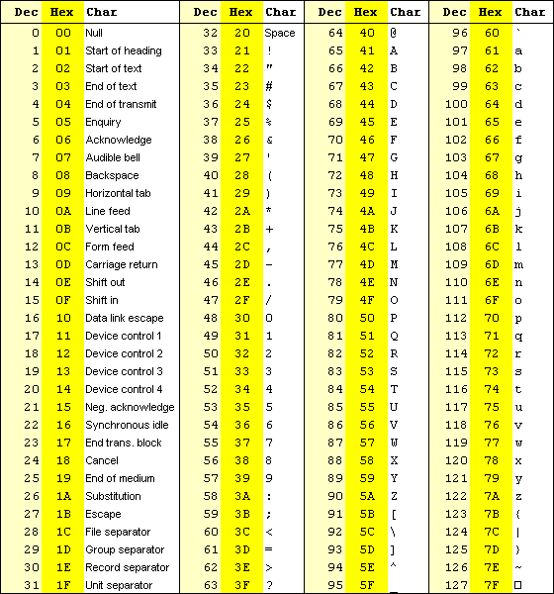
ASCII table
If you ever put one of these codes in your program, you deserve a zero.

Slide 22
Character values
#include <stdio.h>
int main()
{
for (char c = 1; c != 0; ++c) printf("%c\n", c);
return 0;
}

Slide 23
Trouble with printf()
There is nothing type safe in C
What happens when you call printf() with the wrong specifiers?
  Either the wrong types or the wrong number of arguments
printf("%d\n", 13.7);
printf("%x\n", 13.7);
printf("%c\n", 13.7);
printf("%d\n");

Slide 24
Format string practice
What's the difference between %x and %X?
How do you specify the minimum width of an output number?
  Why would you want to do that?
How do you specify a set number of places after the decimal point for floating-point values?
What does the following format string say?
  "%6d 0x%04X\n"

Slide 25
Bitwise Operators

Slide 26
Bitwise operators
Now that we have a deep understanding of how the data is stored in the computer, there are operators we can use to manipulate those representations
These are:
  & Bitwise AND
  | Bitwise OR
  ~ Bitwise NOT
  ^ Bitwise XOR
  << Left shift
  >> Right shift

Slide 27
Bitwise AND
The bitwise AND operator (&) takes:
  Integer representations a and b
It produces an integer representation c
  Its bits are the logical AND of the corresponding bits in a and b
Example using 8-bit char values:
 | 0 | 0 | 1 | 0 | 1 | 1 | 1 | 0 | a
& | 0 | 1 | 0 | 0 | 1 | 1 | 0 | 1 | b
 | 0 | 0 | 0 | 0 | 1 | 1 | 0 | 0 | c
char a = 46;
char b = 77;
char c = a & b; //12

Slide 28
Bitwise OR
The bitwise OR operator (|) takes:
  Integer representations a and b
It produces an integer representation c
  Its bits are the logical OR of the corresponding bits in a and b
Example using 8-bit char values:
 | 0 | 0 | 1 | 0 | 1 | 1 | 1 | 0 | a
| | 0 | 1 | 0 | 0 | 1 | 1 | 0 | 1 | b
 | 0 | 1 | 1 | 0 | 1 | 1 | 1 | 1 | c
char a = 46;
char b = 77;
char c = a | b; //111

Slide 29
Bitwise NOT
The bitwise NOT operator (~) takes:
  An integer representation a
It produces an integer representation b
  Its bits are the logical NOT of the corresponding bits in a
Example using 8-bit char values:
~ | 0 | 0 | 1 | 0 | 1 | 1 | 1 | 0 | a
 | 1 | 1 | 0 | 1 | 0 | 0 | 0 | 1 | b
char a = 46;
char b = ~a; // -47

Slide 30
Bitwise XOR
The bitwise XOR operator (^) takes:
  Integer representations a and b
It produces an integer representation c
  Its bits are the logical XOR of the corresponding bits in a and b
Example using 8-bit char values:
 | 0 | 0 | 1 | 0 | 1 | 1 | 1 | 0 | a
^ | 0 | 1 | 0 | 0 | 1 | 1 | 0 | 1 | b
 | 0 | 1 | 1 | 0 | 0 | 0 | 1 | 1 | c
char a = 46;
char b = 77;
char c = a ^ b; //99

Slide 31
Swap without a temp!
It is possible to use bitwise XOR to swap two integer values without using a temporary variable
Behold!
Why does it work?
Be careful: If x and y have the same location in memory, it doesn't work
It is faster in some cases, in some implementations, but should not generally be used
x = x ^ y;
y = x ^ y;
x = x ^ y;

Slide 32
Upcoming

Slide 33
Next time…
Selection
Loops

Slide 34
Reminders
Read K&R chapter 3
Finish Project 1
  Due tonight by midnight!
Start Project 2

